Slide 1
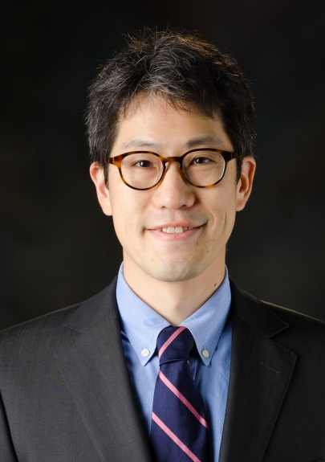
Robert Jenq, MD Associate Professor Genomic Medicine and Stem Cell Transplantation and Cellular Therapy Microbiome, Bacteria and Cancer
Robert Jenq, MD is Deputy Chair of the Department of Genomic Medicine, an Associate Professor in the Departments of Genomic Medicine and Stem Cell Transplantation and Cellular Therapy, and Director of the Microbiome Core Facility at MD Anderson Cancer Center. He received his medical training at Oregon Health and Science University, Duke, and Memorial Sloan Kettering Cancer Center. A practicing medical oncologist, his research efforts have focused on studying the effects of the intestinal bacterial flora on outcomes following immune therapy for cancer, including hematopoietic cell transplantation and checkpoint blockade.
University of Texas MD Anderson Cancer Center

